Slide 1
Mobile Phones, Leadership and Gender in Rural Business Groups
¹Stein Holden and ^{1,2}Mesfin Tilahun
¹School of Economics and Business/
Centre for Land Tenure Studies
²Mekelle University, Department of Economics
Emails: stein.holden@nmbu.no; mesfin.tilahun.gelaye@nmbu.no; mesfintilahungelaye@gmail.com
Presenter:
Mesfin Tilahun
August 23, 2021

Slide 2
Outline
Introduction
Background and objectives
Data and methods
Results
Coclusions

Slide 3
Introduction
Since the beginning of the 21st century, the world has rapidly been adopting information and communication technology tools, which have changed forever the way people communicate and organize social and economic activities and interactions (Negroponte, 1995; Webster, 1995; Castells, 2010; Freeman & Louça, 2001; Hilbert, 2011).
Nevertheless, at the core of the (ICT) revolution is the issue of access to ICT tools, and in particular who is empowered and who is informationally marginalized by use of these tools (Hilbert, 2011).

Slide 4
The Digital Divides
The term “digital divide” has been used in the literature often to conceptualize “the gap between those that have access to vital information technology (ICT) resources and those that do not have access to those resources” (Kularski & Moller 2012; DiMaggio et al., 2004).
Two broad dimensions of the divide (Zhao, Collier, & Deng 2014)
International digital divide (Developed Vs Developing countries)
Domestic digital divide (Rural Vs Urban, Rich vs poor, gender digital divide)
The digital divide is triggered by and may strengthen traditional systems of inequality in terms of, for example, race, socioeconomic status and gender (Kularski & Moller, 2012).

Slide 5
Gender digital divide in developing countries
Digital technologies could, potentially, enable women to overcome longstanding inequalities by providing employment opportunities and chances to increase income, in addition to improving access to cost-effective health care and education (Hilbert, 2011; Antonio & Tuffley, 2014).
Based on empirical analysis, Hilbert (2011) indicated that the reason why fewer women access and use ICT in Africa and Latin America is their unfavorable conditions with respect to employment, education and income.
Geldof (2011) in a study in Ethiopia and Malawi argues that the gender digital divide is mainly socially constructed in these countries.
With regard to the constraints that women face in accessing and using ICTs, Geldof (2011) identified domestic responsibilities, time constraints, limited mobility, and sociocultural norms as important factors.

Slide 6
Background: ICT in Ethiopia
The introduction of telecommunication services into Ethiopia dates back to the early decades after the invention of telephone by Alexander Graham Bell in 1874.
The service was introduced in Ethiopia in 1894 (Tsigie & Feyissa, 1999).
Although telecommunication services in Ethiopia started some 125 years ago, the development of the sector stagnant for almost one century.
Source (Dubale, 2010; CIA Fact Book, 2021)
Year | Mobile Phone Subscription
 | Number in million | % to total population
2010 | 6.94 | 7.70
2019 | 38.15 | 34.04

Slide 7
Background: Rural youth business groups in northern Ethiopia
This study was conduced in Tigray region, northern Ethipia
Landless youth within the local communities in the study area may register to become members of youth business groups (Holden & Tilahun, 2018).
Local leaders and experts have identified natural resources such as rehabilitated communal lands and mineral resources that the communities are willing to allocate to youth groups formed by youth from their own communities.
Each group is allocated a demarcated land area or mineral resource that they must take responsibility for.
Groups may be formed through self-selection into groups or based on decisions by local administrations.
The groups establish themselves as primary cooperatives based on cooperative law; and they have to elect a board consisting of five members including leader, vice leader, secretary, accountant and treasurer.

Slide 8
Objectives of the study
Holden & Tilahun, 2018 reported census of 742 youth groups that were engaged in natural resource based business activities (livestock rearing, bee keeping, forestry, horticulture, extraction of mineral resources (sand and stones))
We study these newly formed youth business groups established as primary cooperatives in rural areas in northern Ethiopia.
This is an area where simple mobile phones have become common tools for communication over the last 10-15 years.
The objectives are to assess:
ownership of simple mobile phones among male and female youth business group members,
whether there is a gender divide in the ownership of mobile phones, and
how this may influence the position of youth business group members in the boards and leadership positions in the youth business groups.

Slide 9
Data and methods
We used a sample of 1150 youth business group members from 119 youth business groups from five districts in Tigray Region of Ethiopia.
The 119 groups were sampled based on a census in 2016 finding 742 such business groups in these districts (Holden & Tilahun, 2018).
In the survey of members, which took place in July-August 2016, up to 12 randomly sampled group members were interviewed among those that were available.
We used instrumental variable techniques with controls for observable and unobservable factors.
We start our analyses with parsimonious models for ownership of mobile phones and add controls to assess the robustness of the basic findings

Slide 10
Results: Descriptives
Table 1. Comparing mobile phone owners with non-owners
 | Mobile phone owner
 | No (n=471) | Yes (n=690) | t-value | P-value
Male dummy | 0.497 | 0.799 | 860.100 | 0.0000
Risk tolerance | 0.398 | 0.475 | 5.352 | 0.0000
Age, years | 29.130 | 28.974 | 0.255 | 0.7990
Education, years | 3.862 | 6.274 | 10.661 | 0.0000
Number of brothers | 2.677 | 2.749 | 0.736 | 0.4621
Number of sisters | 2.295 | 2.417 | 1.359 | 0.1746
Birth rank | 2.983 | 3.170 | 1.564 | 0.1183
No. of siblings in group | 0.155 | 0.246 | 2.986 | 0.0029
Farm size of parents | 2.421 | 2.242 | 1.387 | 0.1659
Education of parent hhh¹ | 2.085 | 3.936 | 9.314 | 0.0000
Gender of parent hhh | 0.875 | 0.879 | 0.235 | 0.8143
Parent hh has radio | 0.412 | 0.532 | 4.053 | 0.0001
No of oxen of parent hh | 0.841 | 1.049 | 5.233 | 0.0000

Slide 11
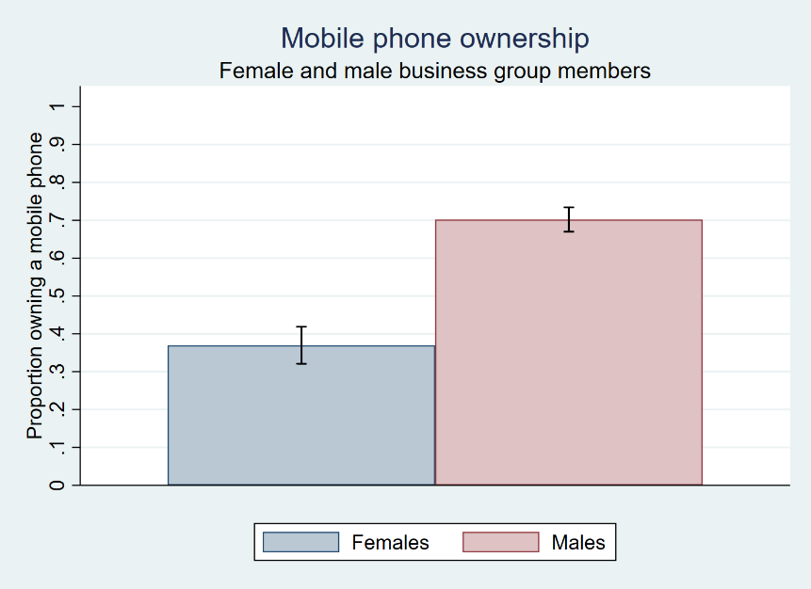
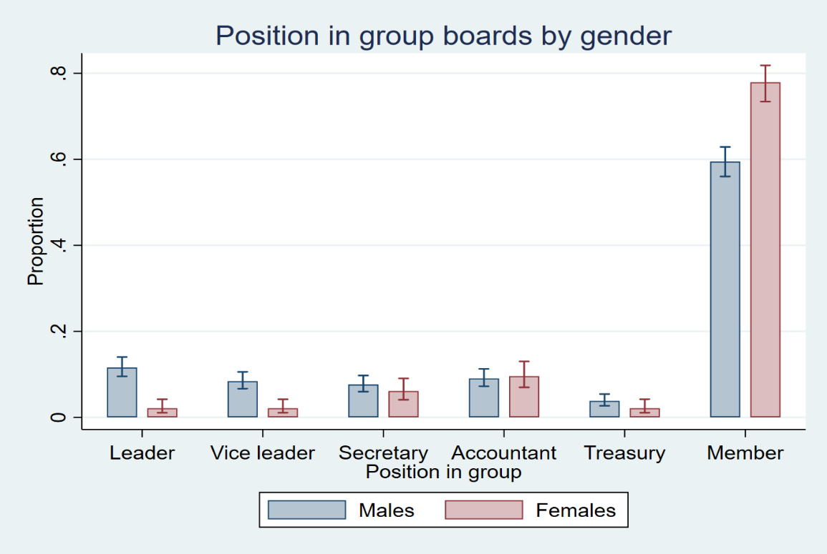
Results: Descriptives
70.19%
36.97%

Slide 12
Results: Descriptive
Table 2. A comparison of the characteristics of youth group board members and leaders versus other group members
 | ---------------Board member -------------------- |  |  |  | -----------------Group leader -------------------
 | No (n=760) | Yes (n=401) | t-value | P-value | No (n=988) | Yes (n=173) | t-value | P-value
Mobile owner, dummy | 0.501 | 0.771 | 9.695 | 0.0000 | 0.547 | 0.867 | 10.559 | 0.0000
Male dummy | 0.614 | 0.793 | 6.643 | 0.0000 | 0.636 | 0.908 | 10.114 | 0.0000
Risk tolerance | 0.431 | 0.468 | 2.321 | 0.0206 | 0.438 | 0.479 | 1.899 | 0.0588
Age, years | 28.271 | 30.489 | 3.851 | 0.0001 | 28.478 | 32.231 | 5.036 | 0.0000
Education, years | 4.929 | 5.990 | 4.453 | 0.0000 | 5.195 | 5.867 | 2.165 | 0.0313
Number of brothers | 2.700 | 2.758 | 0.585 | 0.5585 | 2.737 | 2.624 | 0.851 | 0.3958
Number of sisters | 2.336 | 2.429 | 1.045 | 0.2964 | 2.362 | 2.399 | 0.306 | 0.7597
Birth rank | 3.054 | 3.170 | 0.939 | 0.3478 | 3.093 | 3.098 | 0.031 | 0.9751
No. of siblings in group | 0.205 | 0.217 | 0.354 | 0.7238 | 0.206 | 0.225 | 0.394 | 0.6937
Farm size of parents | 2.488 | 1.985 | 4.058 | 0.0001 | 2.385 | 1.914 | 3.058 | 0.0025
Education of parent hhh¹ | 2.664 | 4.175 | 6.745 | 0.0000 | 2.983 | 4.347 | 4.309 | 0.0000
Gender of parent hhh | 0.870 | 0.892 | 1.138 | 0.2555 | 0.873 | 0.901 | 1.073 | 0.2845
Parent hh has radio | 0.446 | 0.554 | 3.502 | 0.0005 | 0.472 | 0.549 | 1.884 | 0.0609
No of oxen of parent hh | 0.955 | 0.983 | 0.700 | 0.4843 | 0.956 | 1.012 | 1.002 | 0.3174

Slide 13
Results: Analytical
Table 3. Factors associated with youth business group members possessing mobile phones
 | OLS | OLS | GRE | First Stage | IVREG | IVGFE
 | mobile1 | mobile2 | mobile3 | Education | mobile4 | mobile5
Male, dummy | 0.332(0.029)*** | 0.311(0.027)*** | 0.306(0.028)*** | 0.374(0.236) | 0.310(0.029)*** | 0.313(0.029)***
Risk tolerance |  | 0.182(0.052)*** | 0.167(0.050)*** | 0.258(0.342) | 0.178(0.049)*** | 0.131(0.050)**
Education, years |  | 0.038(0.004)*** | 0.032(0.005)*** |  | 0.033(0.008)*** | 0.032(0.009)***
Instruments
Age |  | 0.002(0.002) | 0.0003(0.002) | -0.181(0.0112)***
Parents have radio |  |  | 0.0263(0.025) | 0.766(0.185)***
Other controls
Farm size of parents |  |  | -0.013(0.007) | 0.237(0.045)*** | -0.017(0.007)* | -0.007(0.007)
No. of brothers |  | -0.003(0.008) | 0.003(0.009) | -0.072(0.057) | 0.005(0.008) | 0.004(0.008)
No of sisters |  | -0.002(0.009) | -0.008(0.009) | 0.107(0.061) | -0.004(0.009) | -0.013(0.009)
Birth rank |  | 0.012(0.007) | 0.012(0.007) | -0.113(0.046)* | 0.012(0.007) | 0.012(0.007)
No of siblings in group |  | 0.050(0.024)* | 0.024(0.022) | 0.134(0.163) | 0.037(0.023) | -0.010(0.025)
Education of parents |  |  | 0.016(0.004)*** | 0.443(0.028)*** | 0.015(0.005)** | 0.016(0.005)**
No. of oxen of parent hh |  |  | 0.120(0.030)*** | 0.100(0.165) | 0.115(0.027)*** | 0.145(0.034)***
District FE | No | No | Yes | Yes | Yes | -
Main activity FE | No | No | Yes | Yes | Yes | -
Group Effects | No | No | RE | No | No | FE
Constant | 0.370(0.024)*** | -0.003(0.068) | 0.193(0.081)* | 3.403(0.934)*** | 0.182(0.065)** | 0.158(0.138)
Observations | 1161 | 1161 | 1125 | 1148 | 1148 | 1125
R-squares | 0.1000 | 0.2060 | 0.2599 | 0.5850 | 0.2630 | 0.3720
Wooldridge's robust score (p-value) |  |  |  |  | 0.9629 | 0.9447
Sargan's chi-sq. test (p-value) |  |  |  |  | 0.3024 | 0.3144
First stage F-value |  |  |  |  | 184.948 | 150.192

Slide 14
Results: Analytical
Table 4. Factors associated with youth group members becoming group leader/vice leader
 | Leader1 | Leader2 | Leader3 | Leader4 | Leader5 IV-GFE
Male, dummy | 0.144(0.016)*** | 0.156(0.016)*** | 0.162(0.019)*** | 0.116(0.020)*** | 0.119(0.022)***
Risk tolerance | 0.058(0.042) | 0.048(0.042) | 0.058(0.047) | 0.038(0.047) | 0.040(0.046)
Age | 0.004(0.001)** | 0.005(0.001)*** | 0.007(0.002)*** | 0.009(0.002)*** | 0.012(0.002)***
Education, years |  |  |  | 0.007(0.004) | 0.023(0.008)**
Mobile phone, dummy |  |  |  | 0.136(0.022)*** | 0.115(0.026)***
Individual controls | Yes | Yes | Yes | Yes | Yes
Parent househ. controls | No | Yes | Yes | Yes | Yes
Main activity FE | No | Yes | - | - | -
District FE | No | Yes | - | - | -
Youth group effects | RE | RE | FE | FE | FE
Constant | -0.063(0.041) | -0.083(0.056) | -0.195(0.065)** | -0.301(0.070)*** | -0.352(0.080)***
N | 1138 | 1125 | 1125 | 1125 | 1125
R-sq, overall | 0.0567 | 0.0919 | 0.0970 | 0.1270 | 0.1590
Wooldridge's robust score (p-value) |  |  |  |  | 0.0526
Sargan's chi-sq. test (p-value) |  |  |  |  | 0.6569
First stage F-value |  |  |  |  | 106.064

Slide 15
Results: Analytical
Table 5. Factors associated with group members being in the youth group board
 | Boardmem1 | Boardmem2 | Boardmem3 | Boardmem4 | Boardmem5 IV-GFE
Male, dummy | 0.162(0.031)*** | 0.176(0.030)*** | 0.176(0.036)*** | 0.106(0.038)** | 0.105(0.033)**
Risk tolerance | 0.100(0.055) | 0.086(0.052) | 0.085(0.055) | 0.055(0.055) | 0.054(0.056)
Age | 0.004(0.002)* | 0.006(0.002)** | 0.008(0.002)*** | 0.010(0.002)*** | 0.016(0.003)***
Education, years |  |  |  | 0.007(0.005) | 0.040(0.010)***
Mobile phone, dummy |  |  |  | 0.212(0.030)*** | 0.174(0.037)***
Individual controls | Yes | Yes | Yes | Yes | Yes
Parent househ. controls | No | Yes | Yes | Yes | Yes
Main activity FE | No | Yes | - | - | -
District FE | No | Yes | - | - | -
Youth group effects | RE | RE | FE | FE | FE
Constant | 0.036(0.061) | -0.043(0.087) | -0.090(0.095) | -0.226(0.103)* | -0.314(0.146)*
N | 1138 | 1125 | 1125 | 1125 | 1125
R-sq, overall | 0.0427 | 0.1140 | 0.1070 | 0.1460 | 0.2010
Wooldridge's robust score (p-value) |  |  |  |  | 0.0040
Sargan's chi-sq. test (p-value) |  |  |  |  | 0.2448
First stage F-value |  |  |  |  | 73.0608

Slide 16
Conclusions
We find a strong gender gap in ownership of mobile phones among youth business group members as male members were about 31 percentage points more likely to possess a mobile phone.
The gender gap in mobile phone ownership was much more important in explaining why male members dominated group boards and leadership positions.
When we also take into account that male group members on average are older than female group members and there being a significant age effect, these together also contribute to the male dominance in group boards and leadership positions.
Education also had positive effects on members being in board membership and leadership positions, this did not contribute to a larger gender gap in such positions as female members did not have less education than male members.
The policy implication for empowerment of women in business is therefore that training campaigns for female group members should stimulate mobile phone ownership and use as an important business instrument.

Slide 17
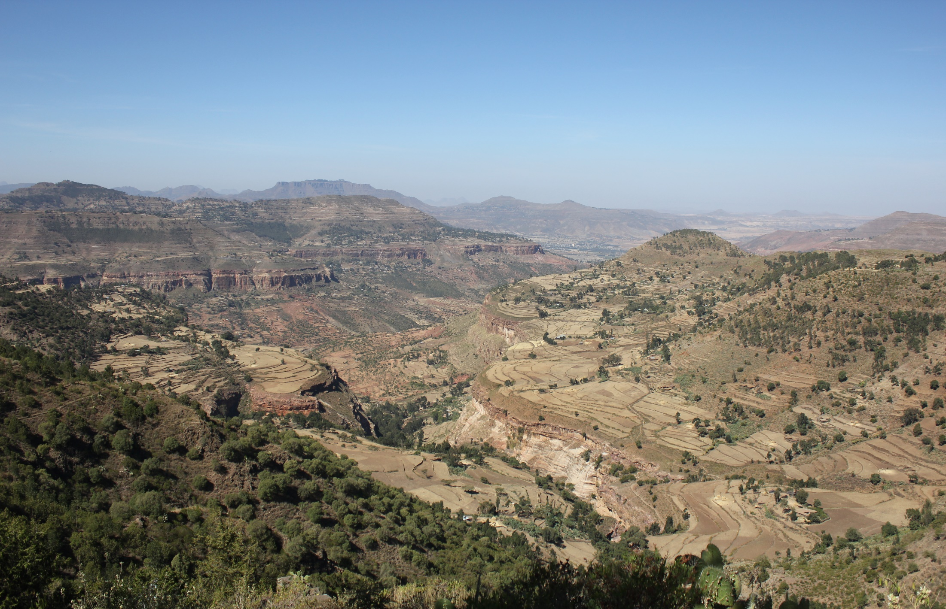
THANK YOU!

