Slide 1
Can rainfall shocks enhance access to rented land? Evidence from Malawi
Sarah E. Tione & Stein T. Holden

Slide 2
OUTLINE
Introduction
Research Question
Hypotheses
Theoretical Framework, Data and Empirical methods
Results and Policy implications

Slide 3
Introduction
Scholarly papers in SSA indicates,
Farm households use the land rental markets as a coping strategy ex-post downside rainfall shocks in form of distress renting out agricultural land.
(Gebregziabher & Holden, 2011; Kusunose & Lybbert, 2014: Gebru, Holden, & Tilahun, 2019)
If the rainfall shocks are shifting the supply of agricultural land,
This study investigates the effects of spatial downside and upside rainfall shocks on tenant household renting-in land behavior in Malawi.

Slide 4
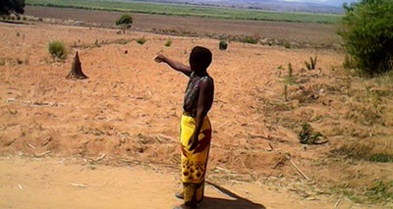
Introduction
The focus is on short- and medium-term fixed-rental contracts that are dominant in Malawi.
These transactions mostly happen on customary land with upfront payments in cash or in-kind.

Slide 5
Research Question
Are spatial variations in downside and upside lagged rainfall shocks kick-starting access to rented land amongst potential tenant households?

Slide 6
Theoretical Framework
Theory: Farm household model applied within the state-contingent framework for risky input choice theory.
The farm household objective is to minimize production cost subjective to state contingent output

Slide 7
Conceptual Framework

Slide 8
Initial year: Two-year lag season
Rainfall deviations
Early to mid-season upside deviations
Early to mid-season downside deviations
Revealed state of nature (Rainfall deviations)
Ex-post household consumption decisions and coping strategies
Production and consumption utility
(Decisions and assumptions)
Land strategy: Rent out
Non-land strategy: Assets or labour sale
Subsequent year: One-year lag season
State-contingent production decisions affected by previous season rainfall deviations
Land decisions: Rent-in
Non-land decisions: Labour and Input use
Revealed state of nature (Rainfall deviations)
Early to mid-season upside deviations
Early to mid-season downside deviations
Crop outcome
Ex-post household consumption decisions and coping strategies
Production and consumption utility
(Decisions and assumptions)
Non-land strategy
Assets or labour sales
Land strategy Rent out
Subsequent year: Current production season
State-contingent production decisions affected by one-year and/or two-year lag rainfall deviations
Non-land decisions
Labour and Input use
Land decisions
Rent-in
Figure 1: Recursive household state-contingent decisions for renting-in the land over time.

Slide 9
Hypotheses
One-year lag downside rainfall deviations (early to mid-season) increase entry and extent of tenant household participation in land rental markets in the subsequent year.
One-year lag upside rainfall deviations (early to mid-season) increase entry and extent of subsequent year tenant household participation in land rental markets.
Rainfall shocks trigger more land rental market participation beyond the immediate effect in the following year.

Slide 10
Data
Nationally representative three-year balanced panel data.
Constructed from the Malawi Living Standard Measurement Surveys (LSMS) collected in 2010, 2013 and 2016.
10-year district level monthly rainfall data from 2007 to 2017.

Slide 11
Empirical Method
Correlated and dynamic random-effects panel probit and Tobit models.
These controls for both unobserved heterogeneity and initial market entry conditions.
The independent variables of interest in the models are;
Lagged downside and lagged upside absolute values of rainfall deviations from 10-year mean values that happen from early to mid-season.
Thus, we run regional models for the central and southern region in Malawi.

Slide 12
Results

Slide 13
Key Results (1)
 | Central Region Models |  |  |  | Southern Region Models
 | Probit Models |  | Tobit Models |  | Probit Models |  | Tobit Models
VARIABLES | CRE | DRE | CRE | DRE | CRE | DRE | CRE | DRE
One-year lag rainfall variables
Positive deviation (dm) one-year lag | 0.00 | 0.00 | 0.00 | -0.00 | -0.00 | -0.01 | -0.01 | -0.01
(Early plus mid-season) | (0.01) | (0.02) | (0.01) | (0.01) | (0.00) | (0.01) | (0.01) | (0.01)
Absolute Negative deviation (dm) one-year lag | 0.04** | 0.04* | 0.02* | 0.01 | -0.00 | -0.00 | 0.00 | -0.00
(Early plus mid-season) | (0.02) | (0.02) | (0.01) | (0.01) | (0.01) | (0.01) | (0.01) | (0.01)
Two-year lag rainfall variables
Positive deviation (dm) two-year lag | -0.01 | -0.02 | -0.01 | -0.01 | -0.01 | -0.01 | -0.01 | -0.01
(Early plus mid-season) | (0.01) | (0.02) | (0.01) | (0.02) | (0.01) | (0.01) | (0.01) | (0.01)
Absolute Negative deviation (dm) two-year lag | 0.03** | 0.03** | 0.02** | 0.02* | -0.03*** | -0.02** | -0.03** | -0.02*
(Early plus mid-season) | (0.01) | (0.01) | (0.01) | (0.01) | (0.01) | (0.01) | (0.01) | (0.01)

Slide 14
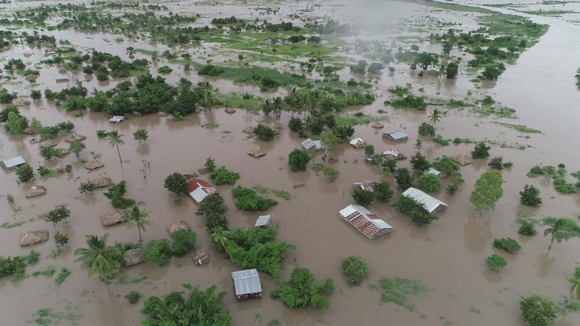
Key Results (2)
Overall,
We only observed a significant effect of the downside lagged shock effects (drought) within the regions
But, not the effect of upside lagged shock effects (floods)
Results show spatial differences in the rainfall shock effects across the regions in Malawi.
These are regions that exhibit different agro-ecological zones; population density and land rental market activity.
Floods from Cylon Idai

Slide 15
Key Results (3): Spatial shock effects
In the Central Region of Malawi, where land rental markets are most active, the one-year and two-year lagged downside rainfall shocks are associated with an increased need to rent land.
For the more land constrained Southern Region of Malawi, with less prevalence of land rental markets, the two-year lagged downside rainfall effects can shrink access to rented land.

Slide 16
Conclusion
We fail to reject H1 in central
We reject H2 in both regions
We fail to reject H3 in both regions but observe different signs

Slide 17
Conclusion
Results in Malawi imply that land markets do not necessarily start to work better
With upside rainfall shocks
Where population pressure is high even with downside rainfall shocks.
Reasons could include:
Households might cling to their land after a downside shock
Limited capital wealth to pay rental prices after a shock

Slide 18
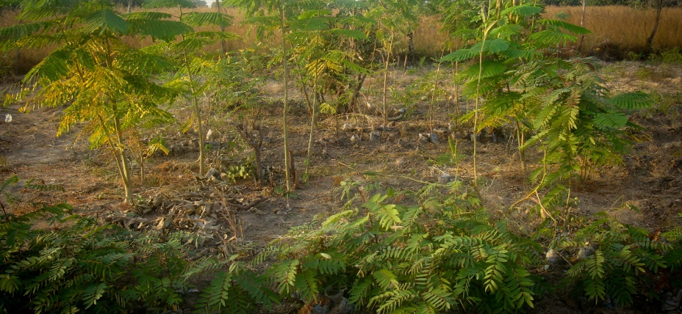
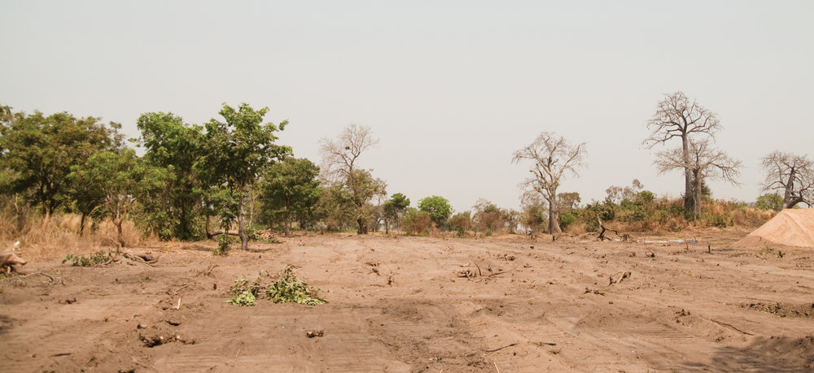
Policy Implication
The results call for area-specific and not blanket national policy strategies that can make land access through markets more affordable in Malawi.

Slide 19
References
Gebregziabher, G., & Holden, S. T. (2011). Distress rentals and the land rental market as a safety net: contract choice evidence from Tigray, Ethiopia. Agricultural Economics, 42, 45-60.
Gebru, M., Holden, S. T., & Tilahun, M. (2019). Tenants’ land access in the rental market: evidence from northern Ethiopia. Agricultural Economics. doi:10.1111/agec.12484
Kusunose, Y., & Lybbert, T. (2014). Coping with drought by adjusting land tenancy contracts: A model and evidence from rural Morocco. World Development, 61, 114-126.

Slide 20
Acknowledgements
I sincerely acknowledge,
The Capacity Building for Climate Smart Natural Resource Management and Policy (CLISNARP) project under NORHED for supporting my studies.
Malawi National Statistics Office and LSMS – ISA World Bank Team for the data.
Department of Climate Change and Meteorological Services in Malawi for the data.

Slide 21
THANK YOU FOR YOUR ATTENTION

