Slide 2
Master's thesis
Important dates, rules and FAQs

Slide 3
Where to start?
Find a topic or hypothesis that you are passionate about!
Attend thesis information meetings
Contact potential supervisors as early as possible.
Main supervisor must be employed at NMBU
Remember important forms and deadlines.

Slide 4
Important Dates and Deadlines
1. June /1. November (year before thesis submission):
Notification – choice of thesis topic
15. October / 15. March (postponed to 1.Des/15.Aug):
Contract – Degree thesis
Register for master's thesis course
Register for special syllabus
15. April / 15. November
Application for extended submission deadline
Postponed/Confidential Thesis
15. May / 15. December: Submission of thesis
All forms and templates can be found here.
Notes:
Spesialpensum – Studieveileder melder opp studentene.

Slide 5
Contract – Degree Thesis
Should be filled out together with supervisor
Try to be as detailed as possible
More than one supervisor: Describe each supervisors responsibilities. Who has the final say?
More than one student: What happens if one gets sick or doesn’t contribute?
Collaborating with an external company?
Agreement – collaborating with external company
Barred/postponed thesis
Restriction required by law
Notes:
Spesialpensum – Studieveileder melder opp studentene.

Slide 6
NMBU Thesis Guidelines
Regulations - Academic regulations for NMBU
Sickness/leave of absence
Late submission
Application of extended submission deadline
Failure to submit by deadline
Oral assessment
Evaluation criteria
Fail grades
Guidelines
Main supervisor must be employed at NMBU
NMBU thesis template
Dissertation or article
30 or 60 ECTS
English or other Scandinavian language
Notes:
Spesialpensum – Studieveileder melder opp studentene.

Slide 7
REALTEK Regulations
All mandatory courses must be completed by the semester you plan on submitting your thesis.
Each student is responsible for making sure their study plan fulfils all requirements.
Your degree must include at least 30 ECTS in 300-level courses.
Feel free to contact any of our study advisors if you have questions.
Students who wish to write an extended 60 ECTS master's thesis must apply to REALTEK
Send application to studieveileder-realtek@nmbu.no
Must include approval from the head of department.

Slide 8
Contact a study advisor as soon as possible!
If you encounter any problems or have questions, contact us sooner rather than later! The earlier we are involved the more likeley we are to be able to help!

Slide 9
Financial support
Funds are earmarked for:
Expenses for field trips
Purchase of equipment and materials for laboratory exercises
Purchase of licenses
Expenses for conferences where the student will present their master's degree project.
Up to 5000kr per student
Budget must be specified in the contract
Must be approved by main supervisor

Slide 10
Reading rooms for Master’s students
teknikum@nmbu.no is in charge of organising all masters reading rooms at REALTEK
Reading rooms are located in «Studentenes hus»
Print, fill out and hang the form on any available spot = the spot is yours
Starts 9th of January 2023
Form can be found here
If you do not use your claimed spot, your form will be taken down and you will loose your spot.

Slide 11
Resources and information

Slide 12
IMPORTANT!! Handeling research data
The student has the operative responsibility as project manager
Talk to your supervisor to assess if you are handeling personal data (yellow and red)
Check if the project should be reported to NSD.
If applicable, report the project to NSD within 30 days before starting the data collection
The Norwegian centre for research data (NSD) assists students at NMBU that will handle personal data in their prosject.
The NSD contact person at NMBU is Jan Olav Aarflot.

Slide 13
Information for students about handling research data and personal data
How to handle and process personal or sensitive research data?

Slide 15
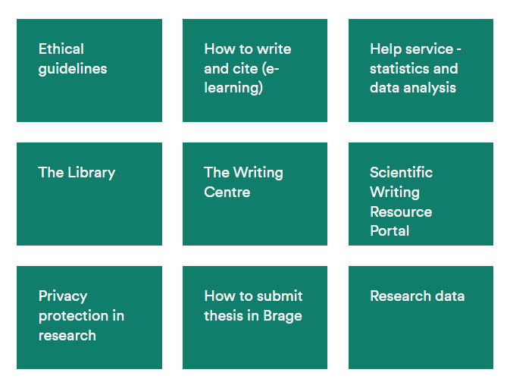
Student Info Center (SiT)

Slide 16
General writing tips
Writing assistance
Book a Consultation
Scientific Writing Resource Portal
YouTube channel
Podcast: It’s going to be all write

Slide 17
End Note
Check out their course schedule
Write & Cite – Understanding plagiarism

Slide 18
Check out previous master’s theses

