Slide 1
Adoption of Drought Tolerant Maize Varieties under Rainfall Stress in Malawi
Sam Katengeza, Stein Holden & Rodney Lunduka
Norwegian University of Life Sciences
AAAE 5th Conference, 23 – 26 September 2016
United Nations Conference Centre – Addis Ababa Ethiopia
FRIDAY 23 SEPTEMBER 2016

Slide 2
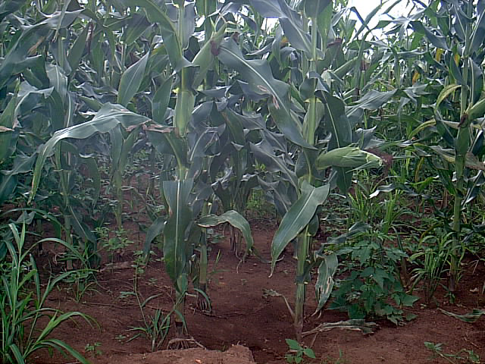
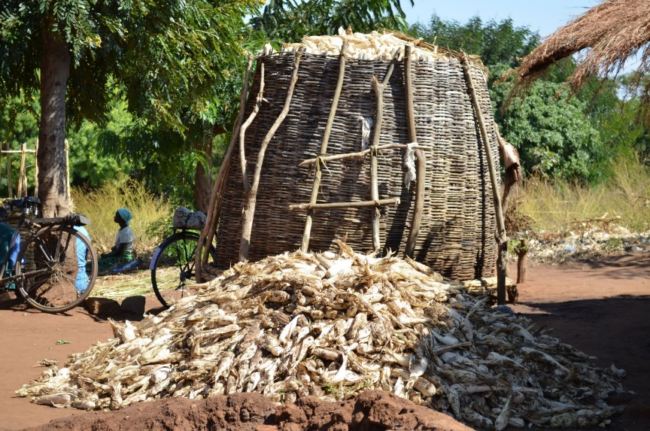
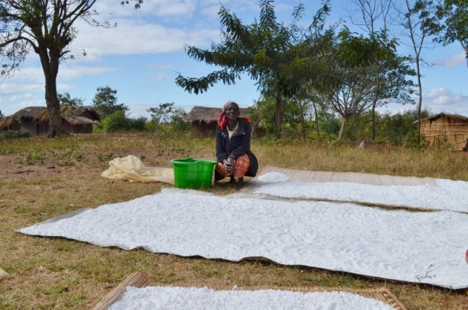
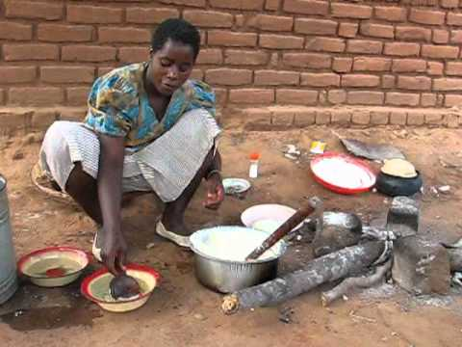
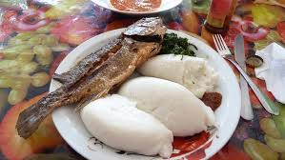
Introduction
Maize = Food security in Malawi. In fact maize is life

Slide 3
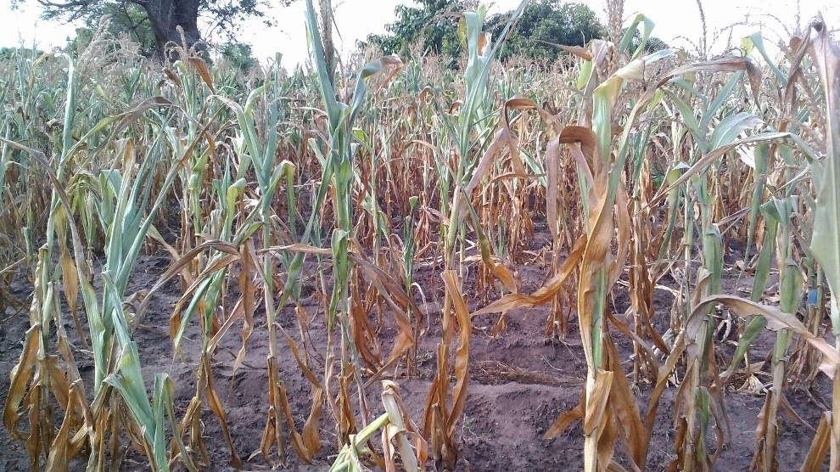
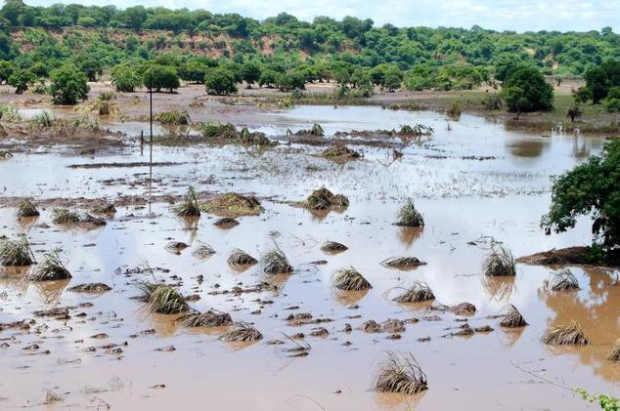
Introduction
However, recurrent weather shocks such as droughts and floods affect agriculture and food security
Maize field affected by droughts in Balaka district, Malawi
Crop field washed away by 2015 floods in Nsanje district

Slide 4
Introduction
To reduce grinding impacts requires significant transformation in agriculture.
Drought tolerant (DT) maize is one potential technology that has the capacity to help smallholder farmers adapt to drought risks.
The government of Malawi is thus promoting DT maize through farm input subsidy programme (FISP).
Sam Katengeza
AAAE 5th Conference, Addis Ababa Ethiopia

Slide 5
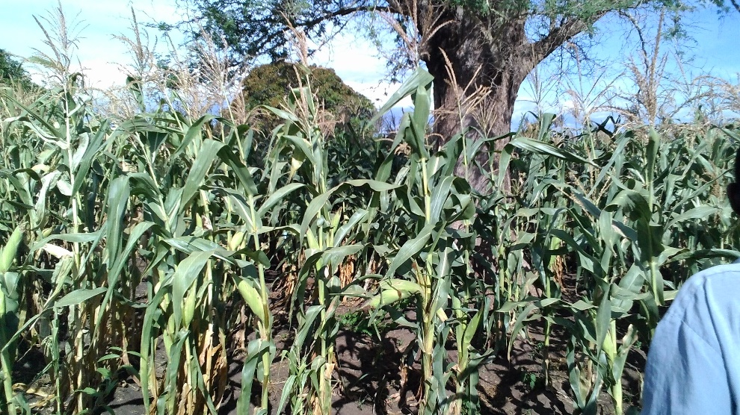
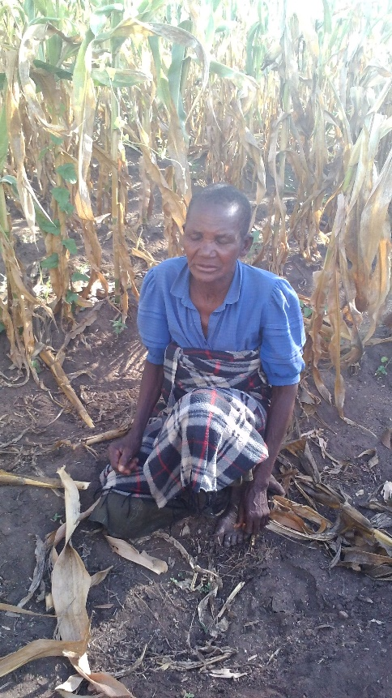
Introduction
On-farm trials show DT maize being superior to other improved hybrids under rainfall stress
DT-Maize under rainfall stress
Other improved maize
Adjacent plots in Balaka, Malawi under on-Farm Trials by CIMMYT

Slide 6
Introduction
There is however growing interest for hard evidence on impacts and adoption.
Absence of rigorous studies create knowledge market distortions which in turn affect policy formulation and implementation.
So the current question is:
Are farmers responding to weather shocks by adopting weather risk minimising technologies such DT maize?

Slide 7
Earlier Studies
Fisher et al. (2015) used cross sectional data from six countries in Africa including Malawi.
Holden and Fisher (2015) used 3-year panel data (2006, 2009 & 2012) for Malawi.
These studies looked at general adoption of DT maize.
Fisher et al. (2015) reported unavailability of improved seed, inadequate information, lack of resources, and high seed price as major barriers to adoption.

Slide 8
Earlier Studies
Holden and Fisher (2015) reported FISP as a major driver of adoption. Also reported are recent droughts and farmer risk aversion.
We build on these two studies using 4-year panel data (2006, 2009, 2012 & 2015) for Malawi to examine adoption of DT maize under rainfall stress conditions.
We focus more on how early and late droughts affect adoption.

Slide 9
Model Specification and Estimation Strategy
Farmers’ adoption decision of DT maize is modelled as follows:
$${DT}_{ipt}=α_{0}+{α_{1}R}_{dt}+ α_{2}S_{ipt}+ α_{3}H_{it}+ α_{4}P_{ipt}+α_{5}{Ds}_{it}+α_{i}+ε_{ipt}$$
${DT}_{ipt}$ = dependent (1:0)
$R_{dt}$ = vector of variables capturing rainfall stress
$S_{ipt}$ = dummy for access to subsidized inputs
$H_{it}$ = household characteristics
$P_{ipt}$= observable farm plot characteristics
${Ds}_{it}$= location variables (survey districts)
$α_{i}$ = captures unobservable time-invariant characteristics
$ε_{ipt}$= normally distributed error term

Slide 10
Model Specification and Estimation Strategy
Farmers’ adoption decision of DT maize is modelled as follows:
$${DT}_{ipt}=α_{0}+{α_{1}R}_{dt}+ α_{2}S_{ipt}+ α_{3}H_{it}+ α_{4}P_{ipt}+α_{5}{Ds}_{it}+α_{i}+ε_{ipt}$$
The parameters are estimated using
Linear Probability model (HHFE and HHRE)
Probit model (HHFE and HHRE)
Mundlak-Chamberlain xtprobit model

Slide 11
Study Areas, Data and Sampling Procedure
The paper uses 4-year panel data from six districts in Malawi.
The data is based on an original sample of 450 households surveyed in 2006, 376 in 2009, 350 in 2012 and 2015.
Data collection involves detailed farm plot level information measured with GPS on plot sizes.
This data captures weather extremes namely, 2006 & 2009 with good rains, 2012 early drought and 2015 flood and late drought.

Slide 12
Results

Slide 13
Descriptive Statistics: Dependent and Explanatory Variables
Variables | Year
 | 2006 | 2009 | 2012 | 2015
DT maize adoption | 0.02 | 0.21 | 0.45 | 0.41
December rain | 6.71 | 7.72 | 7.81 | 7.67
Longest early dry spell | 9.00 | 9.00 | 8.01 | 5.75
Longest early dry spell lag1 | 10.34 | 6.08 | 9.95 | 4.72
Longest early dry spell lag2 | 10.00 | 9.00 | 10.80 | 7.59
Longest late dry spell lag1 | 14.87 | 10.56 | 17.09 | 6.17
Longest late dry spell lag2 | 9.72 | 6.34 | 8.21 | 10.45
6 year average rain | 5.57 | 6.17 | 5.94 | 5.94
Subsidy | 0.36 | 0.61 | 0.79 | 0.52

Slide 14
Descriptive Statistics: Dependent and Explanatory Variables
Variables | Year
 | 2006 | 2009 | 2012 | 2015
DT maize adoption | 0.02 | 0.21 | 0.45 | 0.41
December rain | 6.71 | 7.72 | 7.81 | 7.67
Longest early dry spell | 9.00 | 9.00 | 8.01 | 5.75
Longest early dry spell lag1 | 10.34 | 6.08 | 9.95 | 4.72
Longest early dry spell lag2 | 10.00 | 9.00 | 10.80 | 7.59
Longest late dry spell lag1 | 14.87 | 10.56 | 17.09 | 6.17
Longest late dry spell lag2 | 9.72 | 6.34 | 8.21 | 10.45
6 year average rain | 5.57 | 6.17 | 5.94 | 5.94
Subsidy | 0.36 | 0.61 | 0.79 | 0.52
Adoption increased from 2006 – 2012 but decreased in 2015

Slide 15
Descriptive Statistics: Dependent and Explanatory Variables
Variables | Year
 | 2006 | 2009 | 2012 | 2015
DT maize adoption | 0.02 | 0.21 | 0.45 | 0.41
December rain | 6.71 | 7.72 | 7.81 | 7.67
Longest early dry spell | 9.00 | 9.00 | 8.01 | 5.75
Longest early dry spell lag1 | 10.34 | 6.08 | 9.95 | 4.72
Longest early dry spell lag2 | 10.00 | 9.00 | 10.80 | 7.59
Longest late dry spell lag1 | 14.87 | 10.56 | 17.09 | 6.17
Longest late dry spell lag2 | 9.72 | 6.34 | 8.21 | 10.45
6 year average rain | 5.57 | 6.17 | 5.94 | 5.94
Subsidy | 0.36 | 0.61 | 0.79 | 0.52
FISP increased from 2006 – 2012 but decreased in 2015

Slide 16
Descriptive Statistics: Dependent and Explanatory Variables
Variables | Year
 | 2006 | 2009 | 2012 | 2015
DT maize adoption | 0.02 | 0.21 | 0.45 | 0.41
December rain | 6.71 | 7.72 | 7.81 | 7.67
Longest early dry spell | 9.00 | 9.00 | 8.01 | 5.75
Longest early dry spell lag1 | 10.34 | 6.08 | 9.95 | 4.72
Longest early dry spell lag2 | 10.00 | 9.00 | 10.80 | 7.59
Longest late dry spell lag1 | 14.87 | 10.56 | 17.09 | 6.17
Longest late dry spell lag2 | 9.72 | 6.34 | 8.21 | 10.45
6 year average rain | 5.57 | 6.17 | 5.94 | 5.94
Subsidy | 0.36 | 0.61 | 0.79 | 0.52
Average rainfall been decreasing from 2009 – 2015

Slide 17
Descriptive Statistics: Dependent and Explanatory Variables
Variables | Year
 | 2006 | 2009 | 2012 | 2015
DT maize adoption | 0.02 | 0.21 | 0.45 | 0.41
December rain | 6.71 | 7.72 | 7.81 | 7.67
Longest early dry spell | 9.00 | 9.00 | 8.01 | 5.75
Longest early dry spell lag1 | 10.34 | 6.08 | 9.95 | 4.72
Longest early dry spell lag2 | 10.00 | 9.00 | 10.80 | 7.59
Longest late dry spell lag1 | 14.87 | 10.56 | 17.09 | 6.17
Longest late dry spell lag2 | 9.72 | 6.34 | 8.21 | 10.45
6 year average rain | 5.57 | 6.17 | 5.94 | 5.94
Subsidy | 0.36 | 0.61 | 0.79 | 0.52
Is rainfall stress affecting adoption of DT or simply FISP?

Slide 18
Models without household characteristics
Variables | LPM HHFE | LPM HHRE | PROB HHRE
Access to subsidy | 0.058*** | 0.053*** | 0.060***
Drought variables
December rainfall | -0.012 | -0.011 | -0.030
Longest early dry spell | 0.000 | 0.000 | -0.001
Lagged longest early dry spell | 0.005*** | 0.005** | 0.003
Lagged-2 longest early dry spell | 0.010*** | 0.016**** | 0.008*
Lagged longest late dry spell | -0.003* | -0.005*** | -0.003
Lagged-2 longest late dry spell | 0.005 | 0.002 | 0.013**
Average rainfall | -0.048 | -0.125*** | -0.214
Plot characteristics (soil type, slope and fertility)
Year dummies
2009 | 0.251**** | 0.278**** | 0.326***
2012 | 0.460**** | 0.470**** | 0.452***
2015 | 0.433**** | 0.452**** | 0.380***
Location variables (district dummies)
Zomba |  | 0.259**** | 0.290***
Chiradzulu |  | 0.142**** | 0.148***
Machinga |  | -0.032 | -0.029
Kasungu |  | -0.081 | -0.178
Lilongwe |  | -0.045 | -0.150
Constant | 0.198 | 0.586* | 3.492*
Prob > chi2 | 0.000 | 0.000 | 0.000
Observations | 2500 | 2500 | 2500

Slide 19
Models without household characteristics
Variables | LPM HHFE | LPM HHRE | PROB HHRE
Access to subsidy | 0.058*** | 0.053*** | 0.060***
December rainfall | -0.012 | -0.011 | -0.030
Longest early dry spell | 0.000 | 0.000 | -0.001
Lagged longest early dry spell | 0.005*** | 0.005** | 0.003
Lagged-2 longest early dry spell | 0.010*** | 0.016**** | 0.008*
Lagged longest late dry spell | -0.003* | -0.005*** | -0.003
Lagged-2 longest late dry spell | 0.005 | 0.002 | 0.013**
Average rainfall | -0.048 | -0.125*** | -0.214
FISP increases likelihood of adopt
Early droughts increases likelihood of adopt
Late droughts decreases likelihood
Good rains decreases probability of adopt

Slide 20
Models with household characteristics
Variables | LPM HHFE | LPM HHRE | PROB HHRE | PROB HHREMC
Access to subsidy | 0.063*** | 0.066**** | 0.270*** | 0.060
December rainfall | -0.019 | -0.016 | -0.128 | -0.030
Longest early dry spell | 0.000 | 0.000 | -0.003 | -0.001
Lag longest early dry spell | 0.006*** | 0.005** | 0.012 | 0.003
Lag2 longest early dry spell | 0.012*** | 0.016**** | 0.034* | 0.008*
Lag longest late dry spell | -0.003* | -0.005*** | -0.014* | -0.003
Lag2 longest late dry spell | 0.008* | 0.005 | 0.059** | 0.013**
Average rainfall | -0.061 | -0.140** | -0.951*** | -0.214
Plot characteristics | Yes | Yes | Yes | Yes
Year dummies | Yes | Yes | Yes | Yes
Household characteristics | Yes | Yes | Yes
Location variables | Yes | Yes | Yes

Slide 21
Discussion of results
The results show a significant relationship between farmers’ exposure to drought and adoption of DT maize.
Early dry spells increase the likelihood of adoption but late drought reduces the probability.
Exposure to previous early droughts makes farmers respond to likely reoccurrence of the dry spell in the following year.
Again farmers do replant after an early drought and experience prove early maturing DT maize is preferred.

Slide 22
Discussion of results
Though not conclusive, negative impact of late droughts on adoption could be:
Associated with performance of the varieties (to be studied in detail in the next paper).
Lack of awareness on potential impact of DT
Farmers are still confusing DT and early maturing/drought escaping varieties
Droughts comes late after farmers have already made planting decisions

Slide 23
Conclusion
DT adoption increased from 2006 – 2012 but decreased in 2015
Decrease attributed to substantial decrease in FISP
There is however strong evidence of positive impact of drought
Thus, farmers learn from exposure to drought and respond by adopting risk reducing technologies.
Another important driver of adoption as noted is the farm input subsidy programme.

Slide 24
Key Messages
In the face of weather shocks, promoters of agricultural technologies should first consider those that are perceived by farmers themselves as climate risk reducing.
In Malawi with FISP contributing significantly to adoption, extension messages should be intensified with empirical evidence so that farmers continue using DT even after FISP.
Famers response more to early droughts suggests the need for breeding and disseminating more early maturing DT varieties.
DT varieties should be well labelled accompanied by good extension messages to allow farmers make informed decisions.

Slide 25
Next?
Empirical evidence on impact of DT maize on productivity increase in the face of weather shocks.
Dynamics of adoption of other climate-smart agriculture technologies other than DT maize.

Slide 26
THE END
THANK YOU FOR YOUR ATTENTION

